Slide 1


Sponsorship Package
Our Story
2024 - 2025

Slide 2
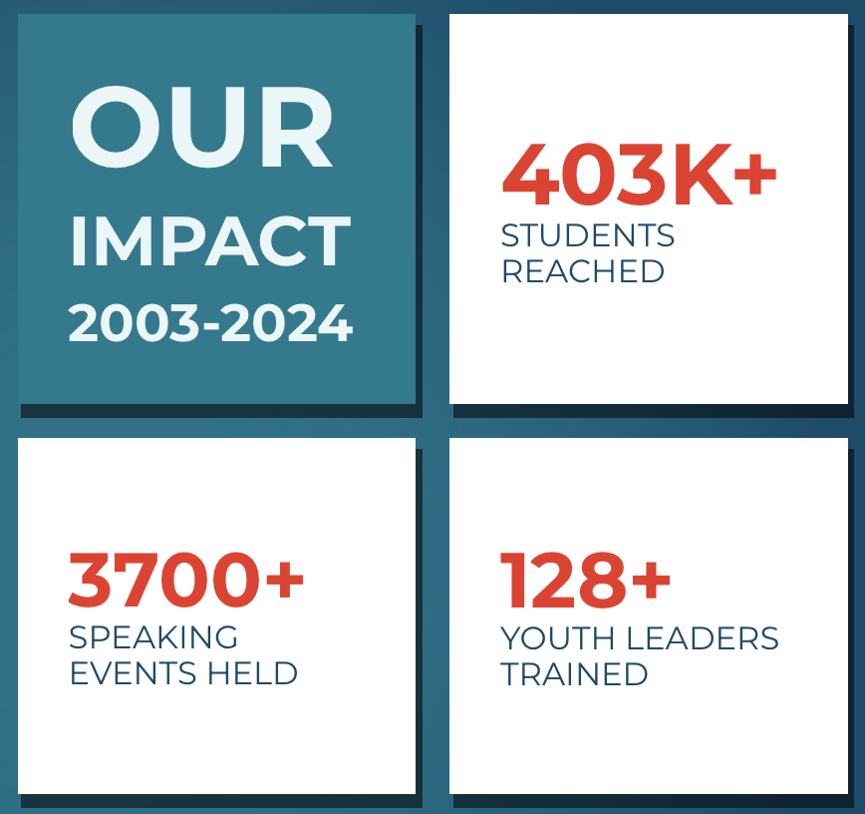
WHO IS YOUTHSPEAK?
  Through youth leadership, training, and sharing personal stories, YouthSpeak empowers youth to build resilience.
  MISSION
  To create important conversations promoting well-being, compassion and hope, by empowering youth to share personal stories and coping strategies through in-person and online presentations.
  VISION
  For all youth to be inspired and empowered to live resilience and meaningful lives.
Across Greater Toronto
Notes:
Tags: statement, vision, overview, left aligned text, right aligned image

Slide 3
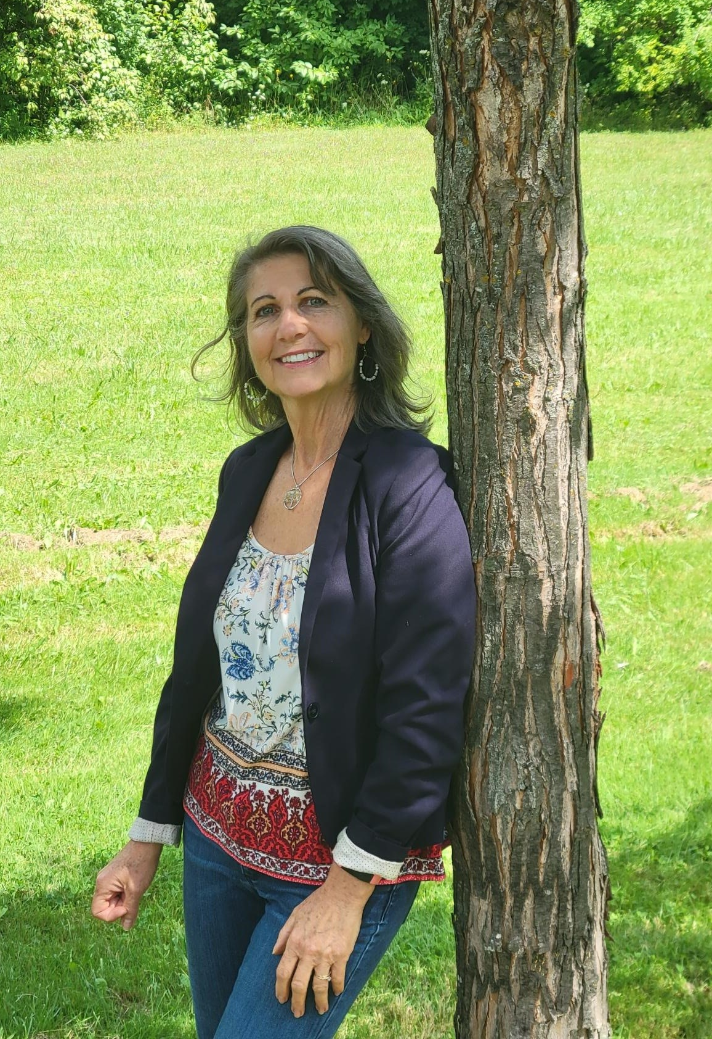
YOUTHSPEAKS’S FOUNDER, UNA WRIGHT
YouthSpeak was inspired by Una’s personal experience within her own family.
Her son Gavin was one of the first youth speakers sharing his story during their inaugural year, until he died on his 19th birthday in a weather-related car accident – July 18th, 2004. Ten years later her eldest son, Kyle took his own life. He struggled with bipolar disorder for many years. Giving value and meaning to these challenges is a fundamental principle behind this work.
According to Una:
“When a youth is going through challenges in mental health, bullying or addiction, a personal connection to someone who shares their story and a message of hope, helps them to feel less alone. This can make a life-saving difference in a young person's life.​”

Slide 4
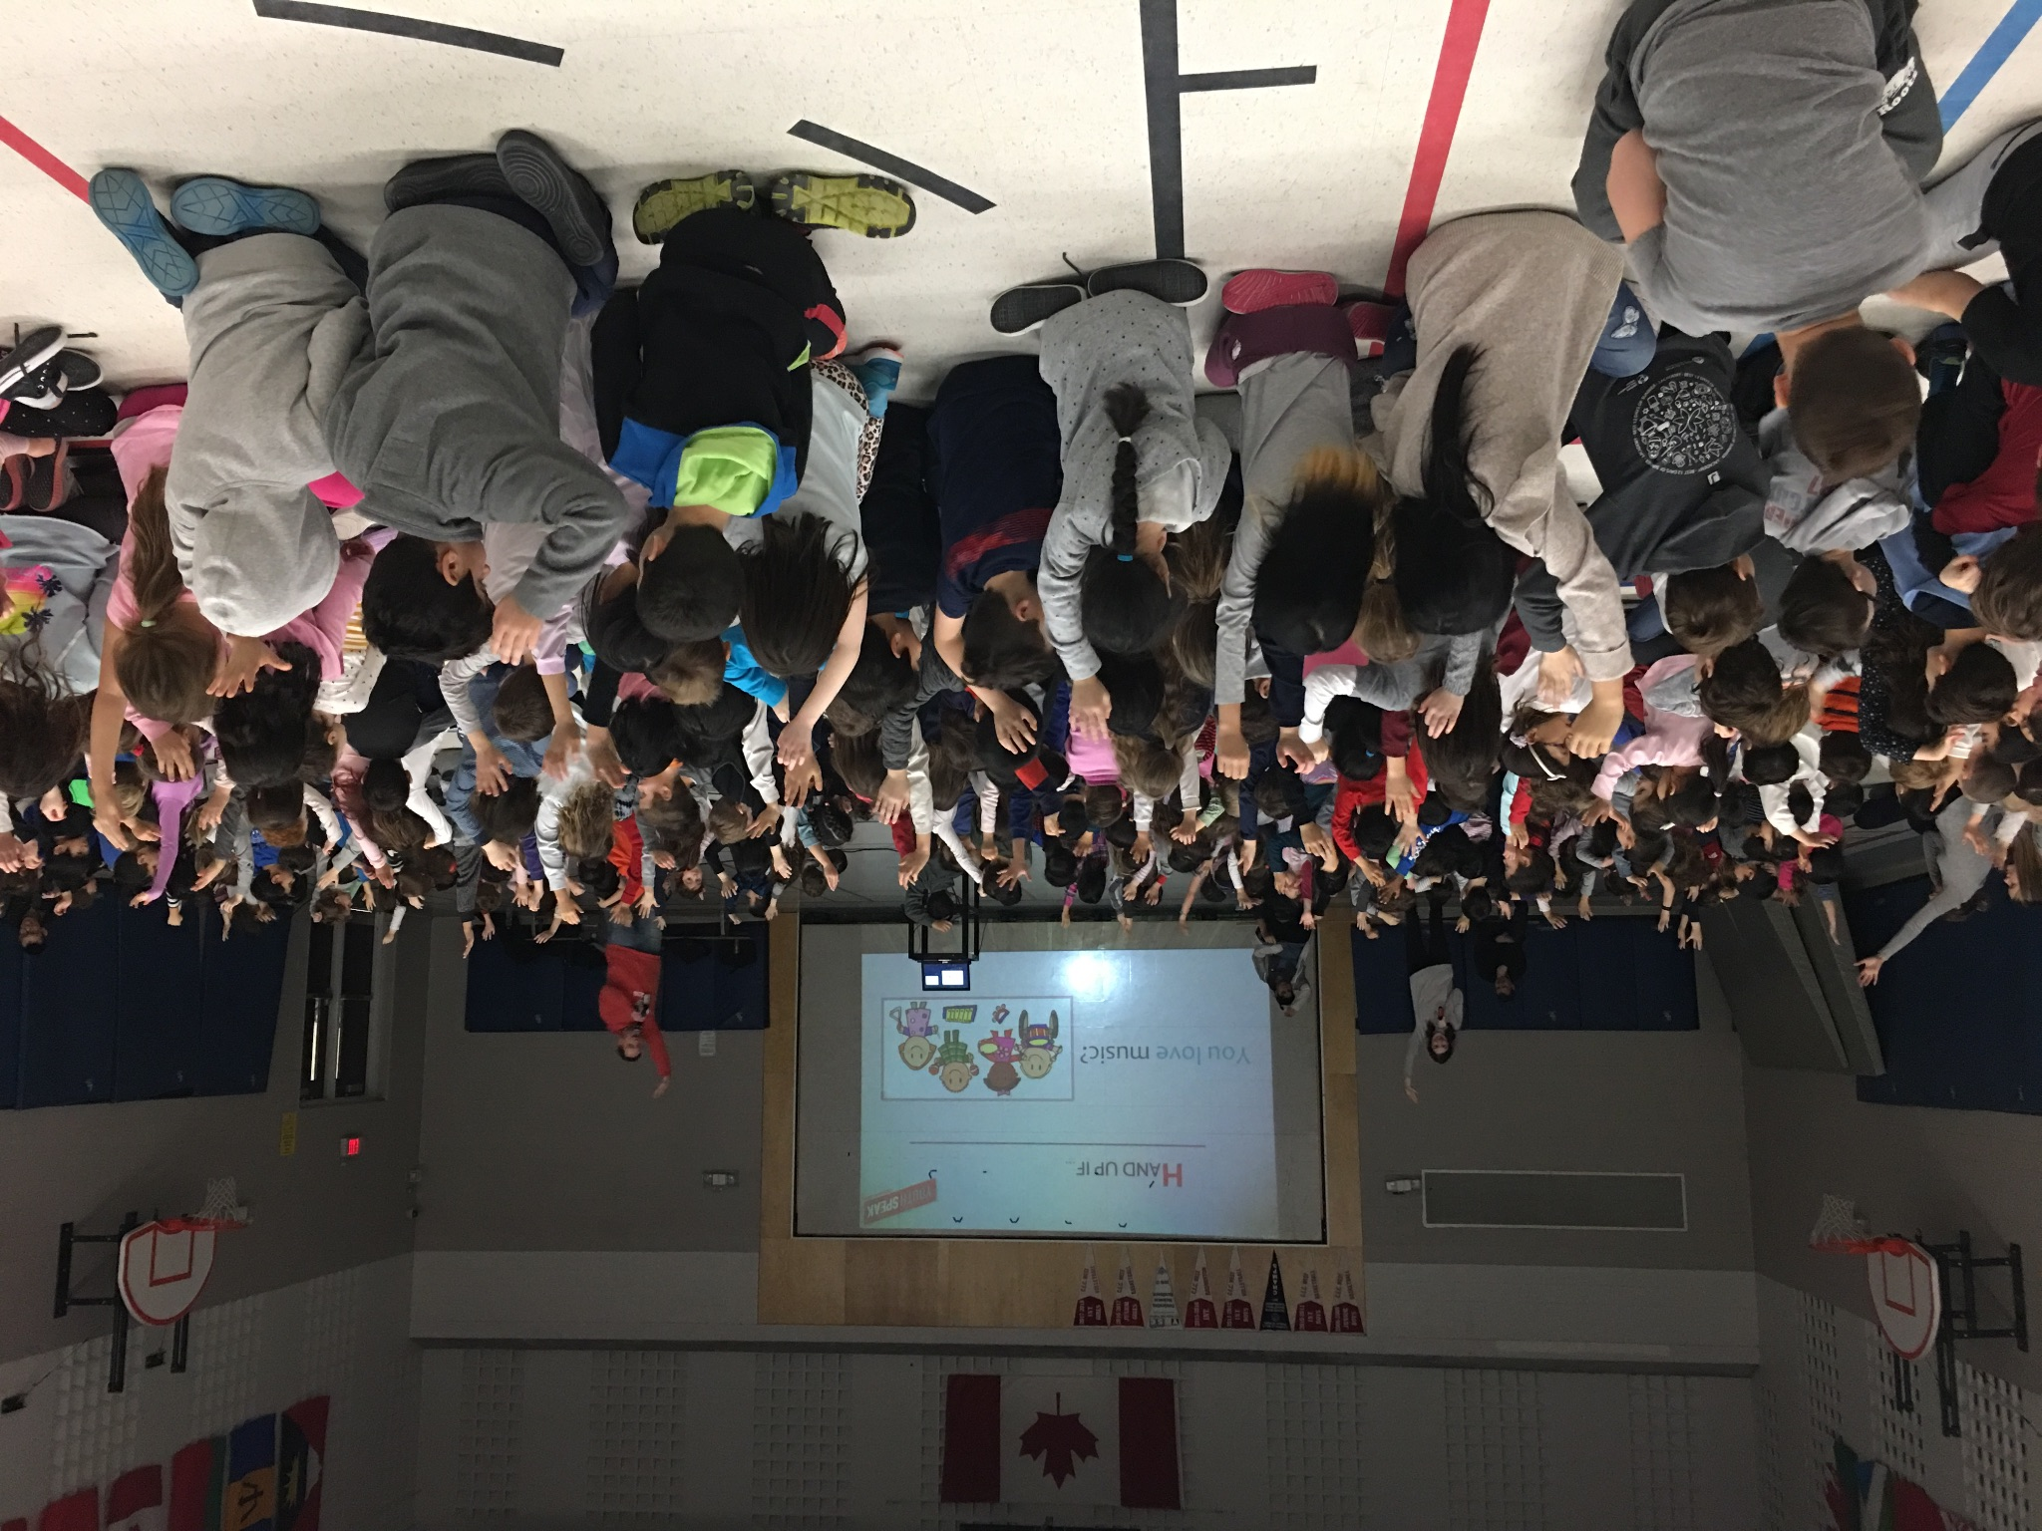
DONATE NOW
THE NEED FOR CHANGE IS CRITICAL
Now, more than ever, youth are facing mental health challenges as NEW STRESSORS, equity and ONLINE ISSUES have increased, along with concerns about their futures – there is so much for them to navigate in today’s changing world.
Notes:
Tags: approach, customer journey, to and from, arrow, icons, priorities

Slide 5


THE NEED FOR CHANGE IS CRITICAL
“Young people are more likely to experience mental illness and/or substance use disorders than any other age group. Without access to support or resources, many will turn to negative coping strategies, including self-harm, substance misuse and even suicide.”
- CMHO, 2020

Slide 6
WHAT WE DO AT YOUTHSPEAK
Youth-Led Interactive Presentations
Trained Youth Facilitators/ speakers deliver interactive presentations on mental health & wellness, substance use and related issues such as bullying, inclusivity, online overdrive, anti-racism, anti-homophobia for grades 2-12, and youth-serving organizations.
Includes printable resource materials i.e. Parent e-book.
Caring Adult Workshops
&
Youth Facilitators/speakers provide workshops for parents, educators and other caring adults on creating a safe space and building positive relationships with youth.
Includes printable resource materials i.e. Parent e-book.
Youth Training
& Employment
YouthSpeak provides employment and training opportunities for youth from equity-deserving communities and youth facing barriers. They are engaged a safe and supportive work environment through the Youth Facilitator/speaker role.
Podcast-Spotify
+ YouTube
& IG Live Talks
Youth Facilitators/speakers lead interviews and discussions with special guests who share self-care strategies on various wellness and inclusivity resources, tips and strategies.
Notes:
Tags: text, opportunities, list, numbers

Slide 7


RESEARCH SHOWS
Research indicates that strategic investments in mental health care would save more than they would cost, both in economic savings and budgetary savings...every $1 invested in covering psychological services would yield from $1.78 to $3.15 in savings...ultimately yield a total of $1 billion in budgetary savings after just 11 years.
Henry, A. J, F. (2022). Mental Health care doesn’t need to cost anything. Policy Options. IRPP.
https://policyoptions.irpp.org/magazines/may-2022/mental-health-investments/
Intervention had a significant and positive effect on promoting mental health by improving social and emotional skills(i.e., self-awareness, self-management, social awareness, relationship skills, responsible decision making) and reducing internalizing and externalizing difficulties.
Colomeischi, A. A., Duca, D. S., Bujor, L., Rusu, P. P., Grazzani, I., & Cavioni, V. (2022). Impact of a School Mental Health Program on Children's and Adolescents' Socio-Emotional Skills and Psychosocial Difficulties. Children (Basel, Switzerland)
https://pmc.ncbi.nlm.nih.gov/articles/PMC9688343/

Slide 8
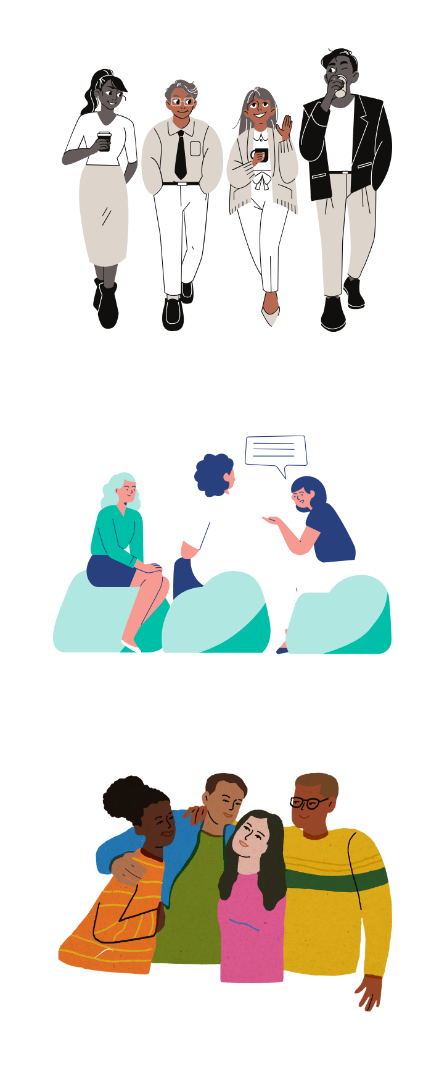

YOUTHSPEAK PROGRAMS ALIGN WITH
Social Determinants of Health Standards
Meaningful youth employment for youth who have been impacted by a range of inequities to help them reach their full potential.
Ontario’s Roadmap Wellness Indicators
• Early identification for early intervention in youth who are aged 10 to 25
• Awareness and/or successful navigation of mental health and addiction services
Provincial Mental Health Strategy
• Strength-based mental health promotion
• Parent, caregiver, community connections, mental health literacy and stigma reduction

Slide 9
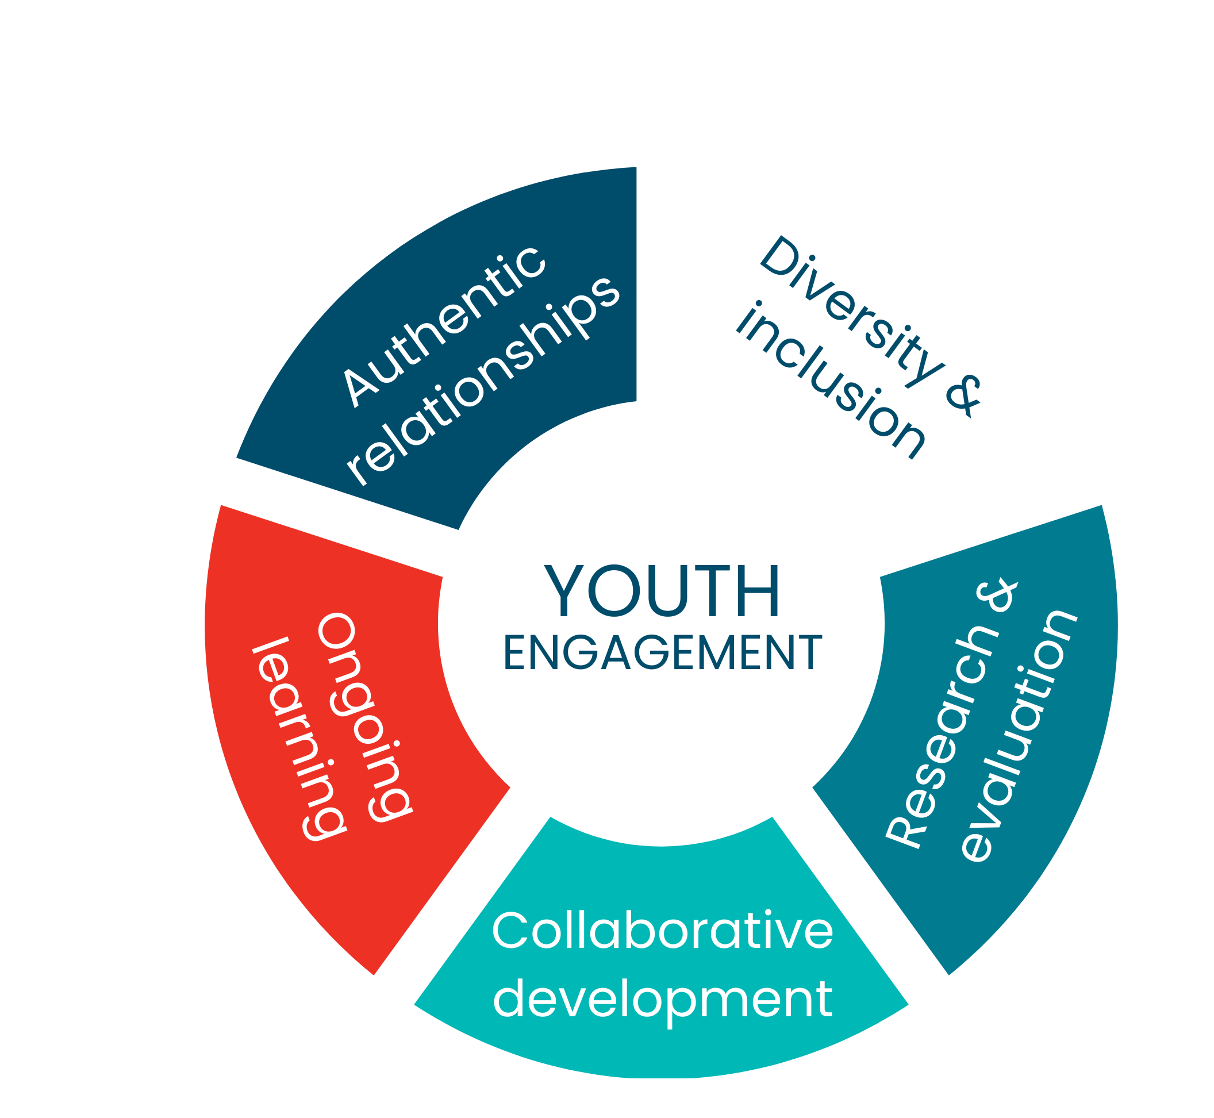
QUALITY STANDARD FOR YOUTH ENGAGEMENT
By aligning with the quality standard for youth engagement, YouthSpeak ensures that youth are involved in decision-making processes and that they are empowered to create positive change in their communities.
(Knowledge Institute on Child and Youth Mental Health and Addictions, 2021)

Slide 10


YOUTHSPEAK’S GOALS OVER THE NEXT YEAR
Increase Reach
Expand Programs
Provide 300 presentations; reaching 30,000 youth and caring adults
Train 15 Youth Facilitators/Speakers in leadership skills
Enhance program offerings to increase learning for youth
Develop and pivot content to address emerging youth mental health needs

Slide 11

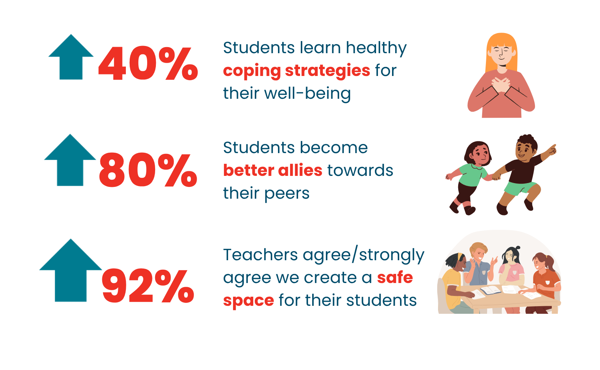
IMPACT
ON STUDENT MENTAL HEALTH
YouthSpeak’s pre and post check-in with students during presentations indicate:

Slide 12

IMPACT
FROM EDUCATOR ENGAGEMENT
79% of respondents rated the presentation as a 5/5 in the following:
Professionalism of the team during presentations
Engaging presentation and creating a safe space for learning
Increased knowledge and understanding of presentation topics
Usefulness of recommended mental health resources

Slide 13

YOUTHSPEAK PROGRAM TESTIMONIALS
Online Overdrive
Mental Health & Wellness
The speakers were super engaging and the stories they shared were powerful and relevant for the students. The students participated actively and asked good questions. It was an awesome experience!
– Annette Livi, Principal,
Sixteenth Avenue PS
Natasha, and Mesha were extremely professional and informative when discussing Mental Wellness. They engaged the students and provided a safe environment to such a difficult topic. My students and I look forward to next year.
– Tony Furfaro, Spec Ed/Library,
Loretto Abbey CSS
Notes:
Tags: qual, image, text

Slide 14

FUNDRAISING GOAL
September 2025 - August 2026
$100,000

Slide 15
HOW YOUR DONATION WILL HELP
Meaningful employment for youth in equity-deserving communities, a safe and supportive work environment, and empowering them to gain life-long transferable skills. Our growing team of youth share their personal stories and coping strategies, which is instrumental in connecting youth who are struggling with help and contributing to the overall well-being of youth in our communities in a way that is unique.
Our training enhances the Youth Facilitator/Speaker’s leadership skills and capacity to deliver quality programs. As well, to be well-equipped to connect youth who are facing challenges with a caring adult within their community. Trainings include: Facilitating and Speaking Skills; Improv; Equity and Trauma-Informed training by various external subject matter experts. As well, Coaching and Support through: Weekly Debrief Meetings; Monthly meetings with a Social Worker.

Slide 16
YOUTH FACILITATOR TESTIMONIALS
As a past victim of bullying and mental illness as a child, all I wanted was to help others who are struggling like I once was. YouthSpeak has changed my life completely, allowing me to fulfill my passion by providing messages of hope, inspiration, and empowerment for youth today.”
– Angelica, Former Youth Facilitator/Speaker
Being part of YouthSpeak is one of the most fulfilling aspects of my life. We bring a lot of ourselves to our work. As a person of colour and someone who was bullied growing up, seeing how my story connects with the students is such a meaningful experience.
- Paul, Youth Facilitator/Speaker
Notes:
Tags: qual, image, text

Slide 17
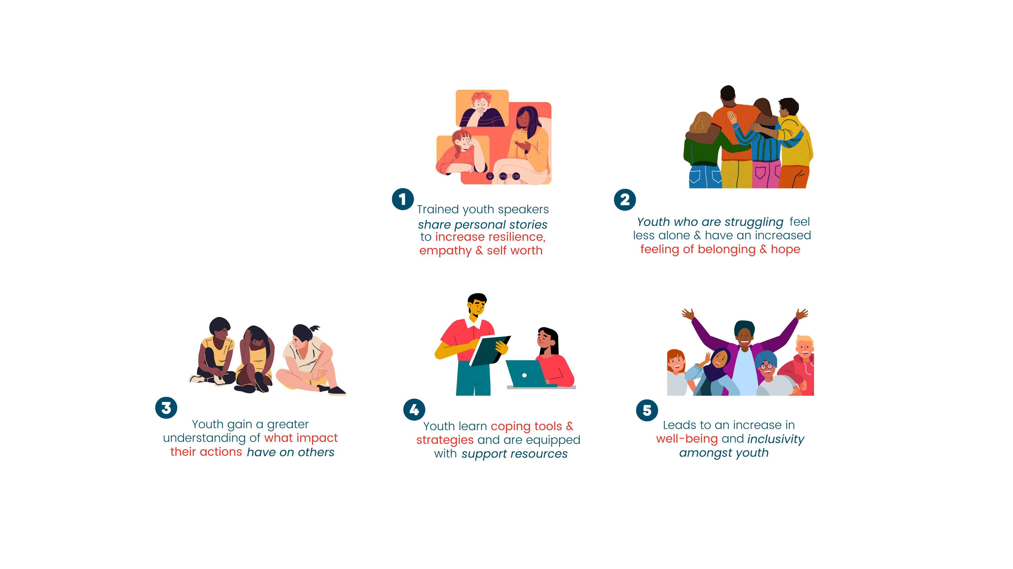

YOUTHSPEAK’S IMPACT IN ACTION
1
3
5
Trained youth speakers share personal stories, to increase resilience empathy and self- worth.
Youth gain a greater understanding off what impact their action have on others.
Leads to an increase in well-being and inclusivity amongst youth.
Youth who are struggling feel less alone and have an increased feeling of belonging and hope.
Youth learn coping tools and strategies and are equipped with support resources.
2
4

Slide 18






ENGAGE WITH YOUTHSPEAK
youthspeak.ca
@youthspeakcan
(905) 967-0604
una@youthspeak.ca
DONATE NOW
DONATE NOW
Notes:
Tags: approach, customer journey, to and from, arrow, icons, priorities

